Slide 1
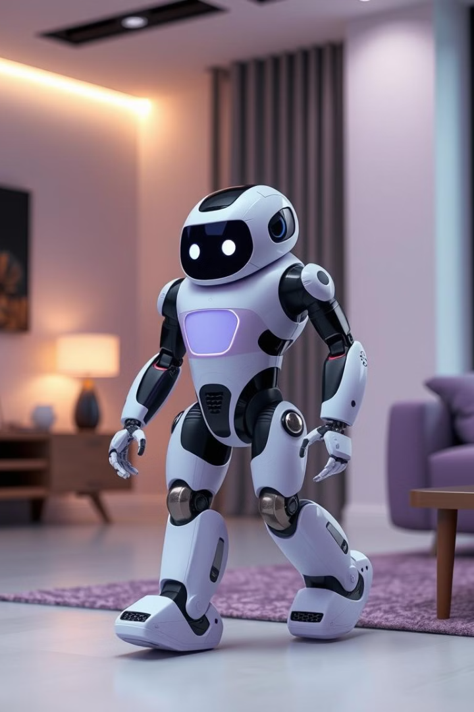
Design an autonomous robot for indoor navigation using A* search for path planning while avoiding obstacles. Equipped with sensors, it dynamically updates its environment knowledge, ensuring real-time path adjustments.
By
Md Sadikur Rahman Sadeed 2112251042
Md.Esak Ali 1921789042
Ahanaf Tahomid 1831920642
Md. Iftekhar Mahmood 2013525042

Slide 2
Node Class Overview
Essential Element
Key Features
The Node class is a fundamental part of the A* path planning algorithm. It represents a position within the environment and stores information related to the path planning process.
Each Node object holds its position coordinates, the cost of reaching it, and the cost to reach the goal from it. This data enables the efficient calculation of optimal paths.

Slide 3
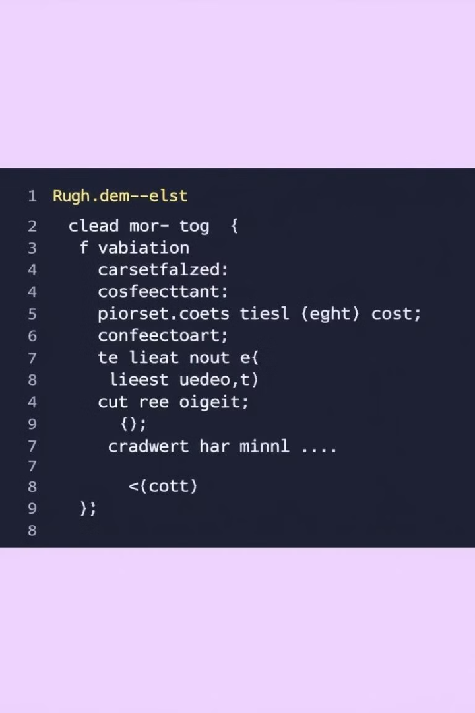
Node Class Structure
Position (x, y): Coordinates of the node within the environment.
Parent Node: Reference to the node from which this node was reached.
Path Cost (g): The cost of reaching this node from the starting position.
Heuristic Cost (h): Estimated cost of reaching the goal from this node.

Slide 4





Node Class Features
Position Tracking: Maintains the (x, y) coordinates of the node within the grid representing the environment.
Parent-Child Relationships: Stores a reference to the parent node, allowing for path reconstruction from goal to start.
Cost Calculations: Calculates the path cost (g) and heuristic cost (h) to guide the search algorithm.
Priority Queue Compatibility: Implements the necessary methods to be used with a priority queue, enabling efficient node sorting for A* search.

Slide 5
Robot Class Overview
Robot Functionality
Key Features
The Robot class encapsulates the functionalities of a mobile robot, including its physical characteristics, movement capabilities, and interaction with the environment.
This class implements unicycle model kinematics, enabling the robot to move and rotate based on its wheel velocities. It also handles path planning and obstacle avoidance, ensuring safe navigation.

Slide 6
Robot Parameters
1
2
3
Position
Orientation
Wheel Radius
(x, y)
(θ)
r
4
5
Base Width
Sensor Range
L
d

Slide 7
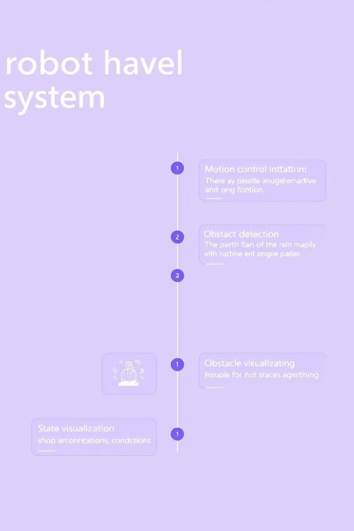
Core Functionalities
1
Motion Control
Implementation of control algorithms to move the robot along a desired path, ensuring accurate trajectory following and obstacle avoidance.
2
Path Planning
Utilizing the A* search algorithm, planning a collision-free path from the current robot position to the target location.
3
Obstacle Detection
Utilizing sensors to detect obstacles in the environment, dynamically updating the map to avoid collisions during navigation.
4
State Visualization
Providing a real-time visual representation of the robot's state, including its position, path, obstacles, and map information.

Slide 8
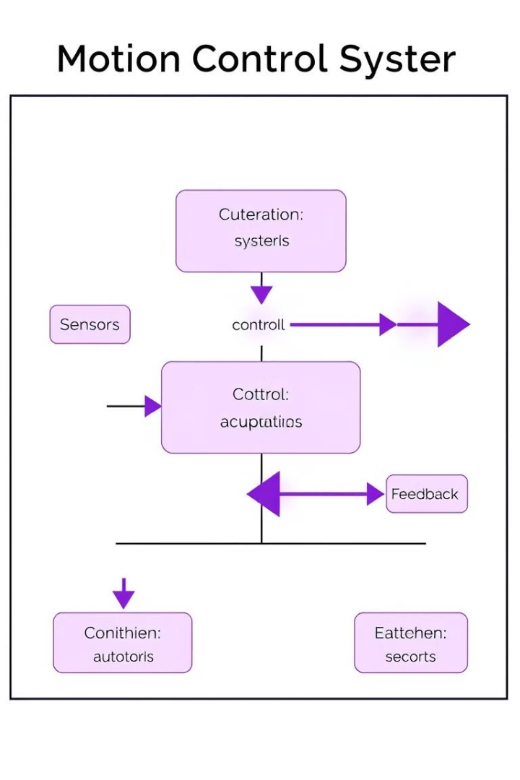



Motion Control
Sensor data: Sensors provide information about the robot's position, orientation, and surrounding environment.
Control Algorithm: Calculates the desired wheel velocities based on the desired path and current state, ensuring accurate robot movement.
Actuators: Receive control signals from the algorithm and drive the robot's wheels to execute the desired motion.

Slide 9
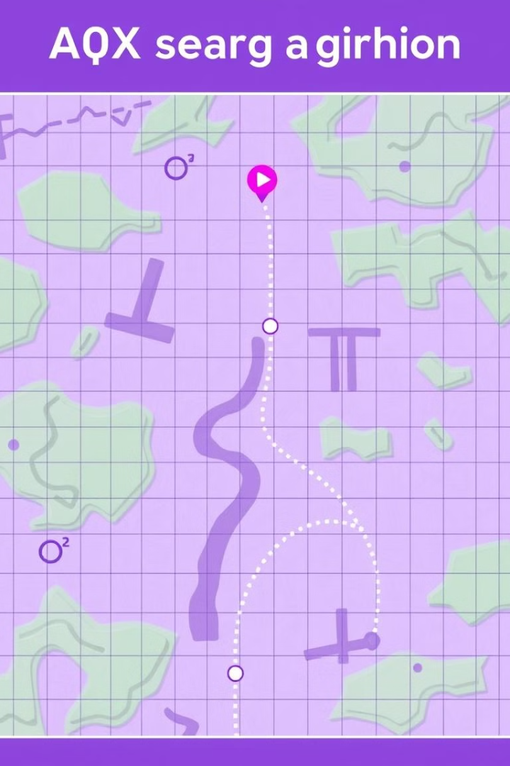
Path Planning
A* Algorithm: A* search efficiently finds the shortest path from the robot's current position to the goal while taking into account obstacles.
Dynamic Replanning: The A* algorithm dynamically replanns the path in real-time, adapting to changes in the environment or new obstacle detections.
Obstacle Avoidance: The planned path ensures that the robot avoids collisions with detected obstacles, maintaining safety during navigation.
Goal Tracking: The algorithm continuously tracks the robot's progress towards the goal, adjusting the path as necessary to reach the target.

Slide 10
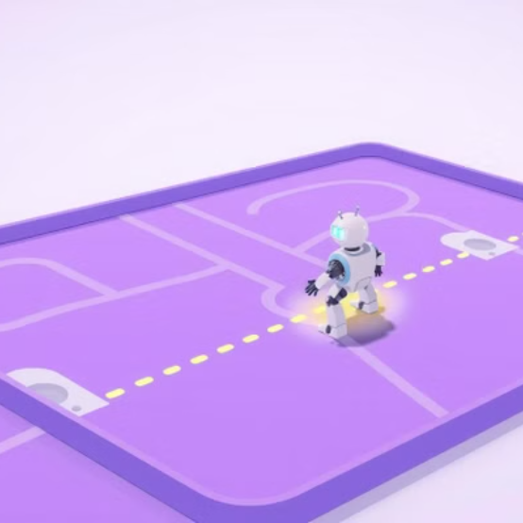

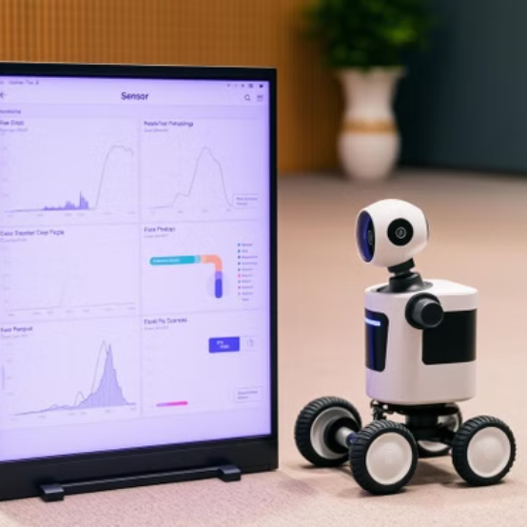
Visualization

Slide 11
Control System
python
def calculate_control_inputs(current_pos, next_pos, current_theta):
# Calculates required velocities
# Uses proportional control
# Returns linear and angular velocities (v, omega)

Slide 12
Technical Specification
Robot Parameters
- Map size: 15x15 grid
- Sensor range: 5.0 units
- Wheel radius: 0.1 meters
- Wheel base: 0.3 meters
- Time step: 0.1 seconds
Control Parameters
- Linear velocity gain (Kp_v): 0.5
- Angular velocity gain (Kp_omega): 1.0
- Maximum velocity limit: 0.5 m/s

Slide 13
Simulation Flow
1. **Initialization**
- Robot creation
- Setting initial pose
- Defining obstacles
- Initial path planning
2. **Main Control Loop**
- Path following
- Continuous state visualization
- Dynamic replanning if needed
- Goal checking

Slide 14
Performance Considerations
1. Dynamic obstacle handling
2. Path smoothing
3. More sophisticated control algorithms
4. Optimization of replanning frequenc
## Usage Example
```python
# Basic usage
robot = Robot()
robot.set_pose(0, 0, 0)
robot.set_obstacles(obstacles)
path = robot.plan_path_astar(start, goal)

Slide 15
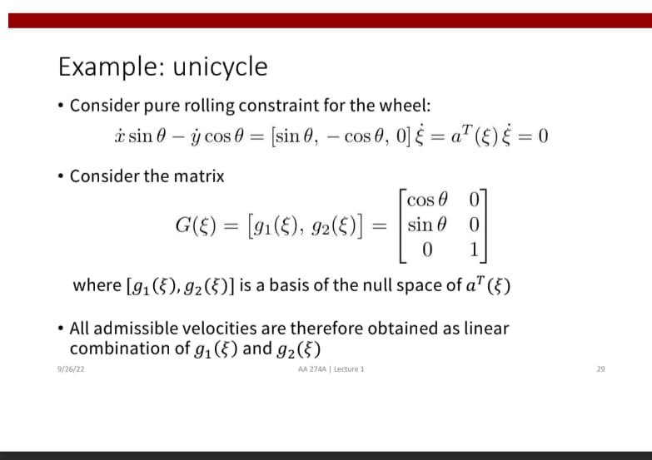
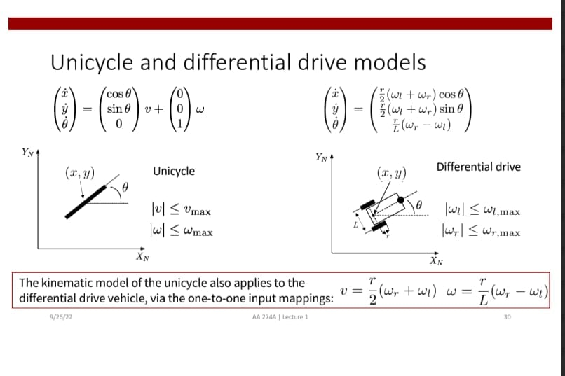
Performance Considerations

Slide 16
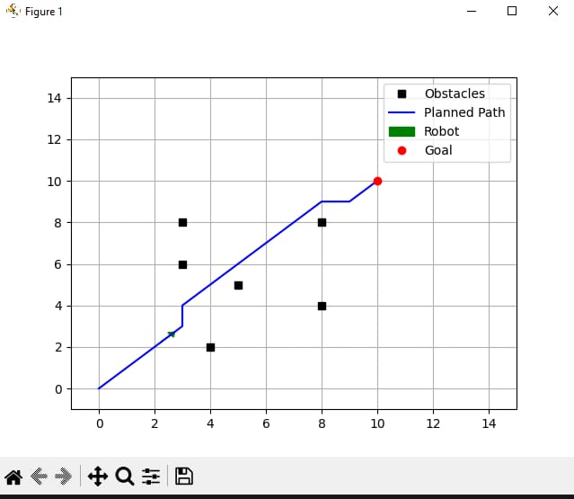
Output

Slide 17
Conclusion
This implementation provides a solid foundation for robot navigation simulation.
It successfully combines path planning, motion control, and visualization in a comprehensive system.
The code is well-structured and modular, making it suitable for educational purposes and further development

